Slide 1

YouTube & Critical Thinking:
Participatory Learning in the Age of Dumb Politics, Doom & Fear
Frederic Murray
Assistant Professor
MLIS, University of British Columbia
BA, Political Science, University of Iowa
Instructional Services Librarian
Al Harris Library
frederic.murray@swosu.edu

Slide 2
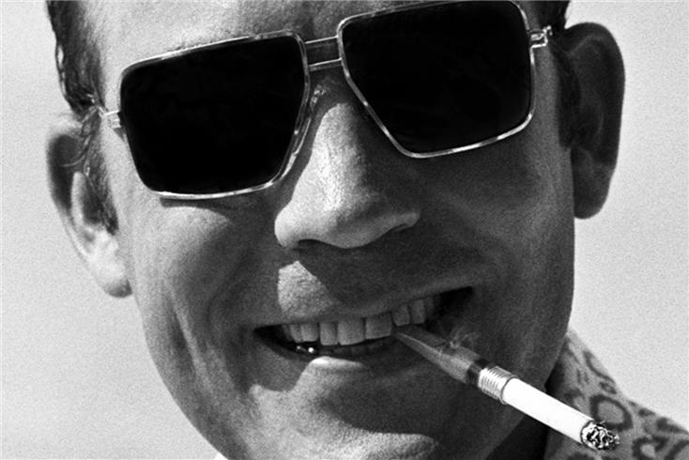
Politics is a Participatory Sport
( and so is this class)
Notes:
Ask someone to volunteer to take notes to write down key points, questions, arguments, solutions, attitudes.

Slide 3
Abstract
As visual and kinesthetic learners our millennial students are accustomed to receiving information via numerous media platforms. Using a “hot button” issue via Web 2.0 technologies (YouTube) is one method to promote critical thinking and information literacy.

Slide 4
Outline of AL Harris Comp II Classes
3-5 sessions
Pro/Con assignment tends to be one of the last
Problem: how to engage the class when they are already familiar w/ many of our library resources

Slide 5
Pro/Con
TOPIC

Slide 6
Fall 2008
Exercise:
Argumentative Resources Worksheet
Topic: Oklahoma HB 2513 & HB 2211 Amends existing law to allow concealed handgun permit holders to carry concealed handguns on college or university property.
Question: Should this law be passed?
Notes:
Fall 2008

Slide 7
Spring 2009
Exercise:
Argumentative Resources Worksheet
Topic: Oklahoma HB 1083 & SB 1101 Amends existing law to allow concealed handgun permit holders to carry concealed handguns on college or university property.
Question: Should this law be passed?
Notes:
Spring 2009

Slide 8
Divide into Groups
Pro
Con
At this juncture the students brainstorm arguments/positions/opinions
&
Share them on the Whiteboard

Slide 9

Where do I start (SWOSU)?
  TOPICsearch -database
  Pro/Con Resources - books
    Contemporary Issues
    Opposing Viewpoints
    Reference Shelf
    Taking Sides
  Pro/Con Resources - databases
    CQ Researcher
    Issues and Controversies

Slide 10
Where do You start (NSU)?
  Academic Search Premier
  Article First
  Ingentia
  Alternative Press Index
  Chronicle of Higher Education
  As well as the usual suspects…..

Slide 11

Helpful Keywords to Use
Issue
Controversy
Statistic
Ethical
Rights
Debate
Attitude
Trend
Condition
Examples:
Rights and poverty
death penalty and Controversy
household spending and Statistics

Slide 12
Finish the Worksheet:
Identify three sources of information in support of your defense.
  A.
  B.
  C.

Slide 13
Abstract
As visual and kinesthetic learners our millennial students are accustomed to receiving information via numerous media platforms. Using a “hot button” issue via Web 2.0 technologies (YouTube) is one method to promote critical thinking and information literacy.

Slide 14
Strengths of this Exercise
Oklahoma Matters
Ed Kelley
Editor, The Oklahoman

Slide 15
A Menu of Frivolity
State Bill 320 (failed)
House Bill 1804 (passed but subject to lawsuit)
House Concurrent Resolution 1028 (Vetoed)
Intelligent Design
Immigration Law
Sovereignty

Slide 16
Critical Thinking:
Raises vital questions and problems, formulating them clearly and precisely
Gathers and assesses relevant information, using abstract ideas to interpret it effectively comes to well-reasoned conclusions and solutions, testing them against relevant criteria and standards
Thinks open-mindedly within alternative systems of thought recognizing and assessing, as need be, their assumptions, implications, and practical consequences
Communicates effectively with others in figuring out solutions to complex problems
Paul, Richard, and Linda Elder. The Miniature Guide to Critical Thinking Concepts and Tools. Berkeley CA: Foundation for Critical Thinking Press, 2008.

Slide 17
Critical Thinking:
is based on universal intellectual values that transcend subject matter divisions
Clarity
Accuracy
Precision
Consistency
Relevance
Sound evidence
Good reasons
Depth, Breadth, and Fairness
"Defining Critical Thinking." About Critical Thinking. 2007. Foundation for Critical Thinking. 3 Jul 2009 <http://www.criticalthinking.org/page.cfm?CategoryID=51>

Slide 18
Elements of a Good Learning Experience
Imitates Reality
Is Active
Responsive to Learning Styles
Accommodates Constantly Changing Information
Students learn best when environment is least threatening/they own the discovery process
Breivik, Patricia, and E. Gordon Gee. Higher Education in the Internet Age: Libraries Creating A Strategic Edge. Westport, CT: Praeger, 2006.

Slide 19
How far do we engage the students politically?
Or…How I learned to stop worrying about the myth of the objective librarian…

Slide 20
If these local issues are driven by inaccurate, fear-driven, specious information…
Question of the Day?
As information professionals where do we step in?

Slide 21


Slide 22
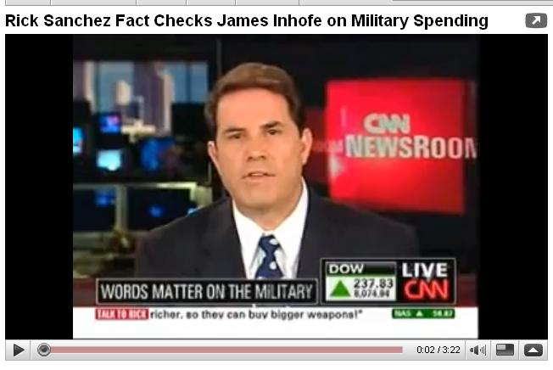
CNN's Newsday April 9, 2009.

Slide 23
Utah University Lifts Ban on YouTube !
By THE ASSOCIATED PRESS
Published: June 27, 2009 NYT
PROVO, Utah (AP) — Brigham Young University, a Mormon Church institution where students agree to live a chaste and virtuous life, has lifted its almost three-year policy of blocking access to YouTube.
Administrators lifted the ban on Friday, citing an increasing amount of educational material on the popular video-sharing site, a university spokeswoman, Carri Jenkins, said.
By THE ASSOCIATED PRESS
Published: June 27, 2009
PROVO, Utah (AP) — Brigham Young University, a Mormon Church
institution where students agree to live a chaste and virtuous life,
has lifted its almost three-year policy of blocking access to YouTube.

Slide 24
Bibliography
Breivik, Patricia, and E. Gordon Gee. Higher Education in the Internet Age: Libraries Creating A Strategic Edge. Westport, CT: Praeger, 2006.
Defining Critical Thinking." About Critical Thinking. 2007. Foundation for Critical Thinking. 3 Jul 2009 <http://www.criticalthinking.org/page.cfm?CategoryID=51>
Paul, Richard, and Linda Elder. The Miniature Guide to Critical Thinking Concepts and Tools. Berkeley CA: Foundation for Critical Thinking Press, 2008.
Sattterwhite, Al. "Hunter S. Thompson, Mexico, 1974." Hunter S. Thompson. 1999. MORRISONHOTEL GALLERY. 3 Jul 2009 <https://www.morrisonhotelgallery.com/set/default.aspx?setID=203&photographID=699>.

Slide 25
and by the way…..
We're the last session for the day, so please head back over to the main building (where we started this morning) for closing thoughts and remarks.

Slide 26
Thanks!

